Slide 1
MySQL Dependency Extraction
Tabs vs. Spaces
Varsha Ragavendran
Nisha Sharma
Davood Anbarnam
Ayman Abualsunun
Anton Sitkovets
Glib Sitiugin
Kevin Arindaeng
Notes:
(10 seconds)

Slide 2
Overview
Introduction
Compare dependency extraction techniques for the following:
Understand
srcML
Our Program
Quantitative & Qualitative Analysis for the following:
Understand vs. srcML
srcML vs. Our Program
Understand vs. Our Program
Potential Risks and Limitations
Lessons Learned
Conclusion
Notes:
Team 3: Ayman, Davood, Varsha
Team 2: Anton, Kevin
Team 1: Nisha, Glib
In today’s presentation, we will be starting off with a brief introduction regarding the purpose of dependency extraction tools for source codes, then moving onto comparing the 3 selected dependency extraction techniques which are:
Understand, srcML, and our program
We will be quantitatively & qualitatively analyzing these tools with one another to understand the rationale as to why there exists a difference, although all 3 tools are parsing the same source code, mySQL.
Next, we will be identifying the potential risks and limitations for each tool, followed by a lesson’s learned and a short conclusion.

Slide 3
Introduction
Dependency extraction techniques help to:
Analyze large open source code architecture to optimize software design
Easily identify dependencies within the code
Understand complex code bases with poor documentation
Notes:
Varsha
Purpose of today’s presentation is to try out different extraction techniques available, on mySQL’s source code.
These dependency extraction techniques help in
Analyzing large open source codes to optimize software design
To easily identify dependencies and interactions within the code
It is also used to quickly understand large or complex legacy code bases.. Often with poor documentation

Slide 4
Dependency extraction using Understand
Dependency Extraction
Quantitative & Qualitative Analysis
Potential Risks & Limitations
Conclusions
Lessons Learned
Understand is a static analysis tool focused on:
source code comprehension, metrics, and standard testing.
A file can depend on another through:
Import
Inheritance
Implementation
Method calls and object initializations
@ Java annotations
Notes:
TEAM 1

Slide 5
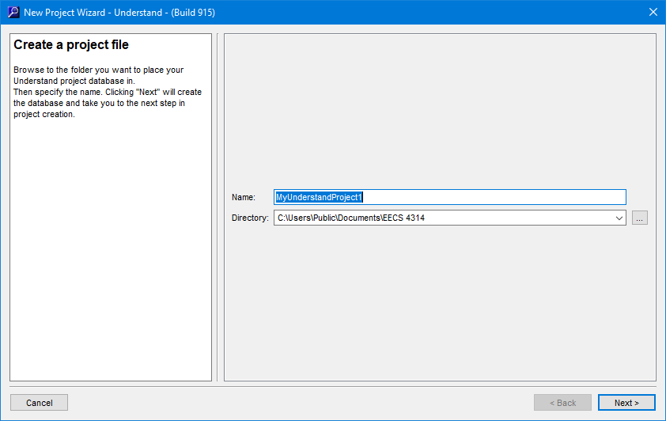

Dependency extraction using Understand
Dependency Extraction
Quantitative & Qualitative Analysis
Potential Risks & Limitations
Lessons Learned
Conclusions
Create a new project
And Name it
Notes:
TEAM 1

Slide 6
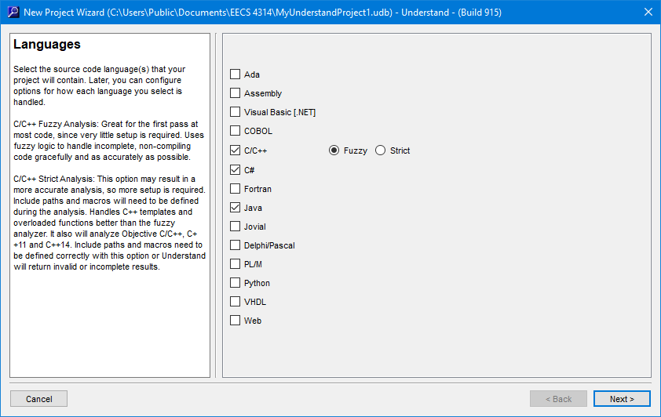
Dependency extraction using Understand
Dependency Extraction
Quantitative & Qualitative Analysis
Potential Risks & Limitations
Lessons Learned
Conclusions
Select the Source Code Languages
Notes:
TEAM 1

Slide 7
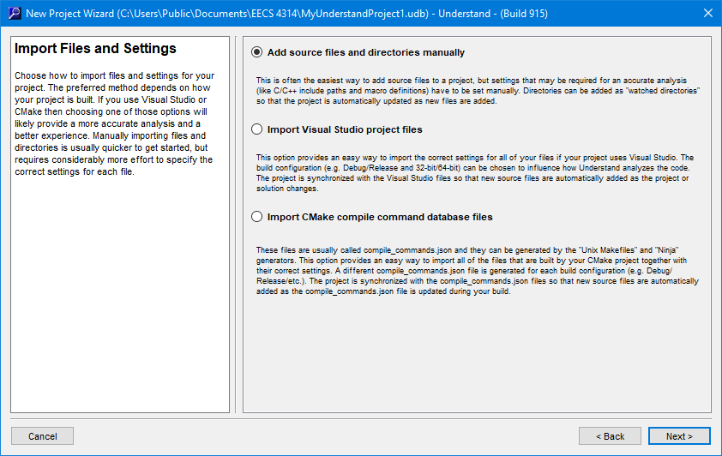
Dependency extraction using Understand
Dependency Extraction
Quantitative & Qualitative Analysis
Potential Risks & Limitations
Lessons Learned
Conclusions
Import Files
Notes:
TEAM 1

Slide 8
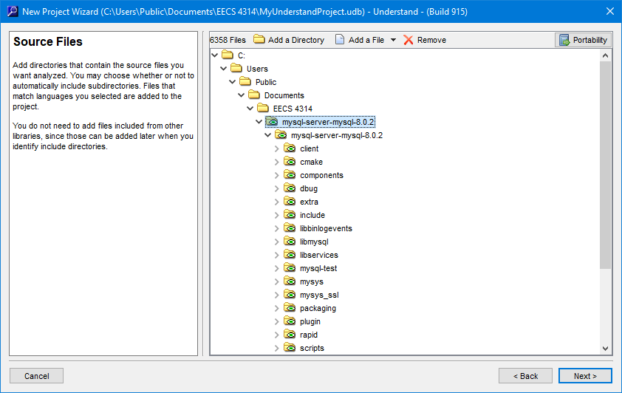
Dependency extraction using Understand
Dependency Extraction
Quantitative & Qualitative Analysis
Potential Risks & Limitations
Lessons Learned
Conclusions
Add Directory
Notes:
TEAM 1

Slide 9
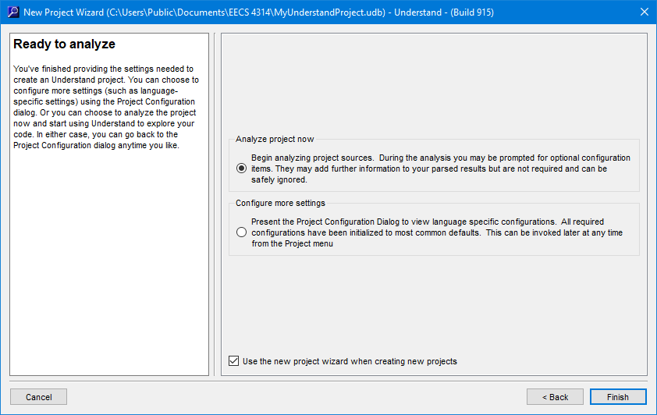
Dependency extraction using Understand
Dependency Extraction
Quantitative & Qualitative Analysis
Potential Risks & Limitations
Lessons Learned
Conclusions
Analyze
Notes:
TEAM 1

Slide 10
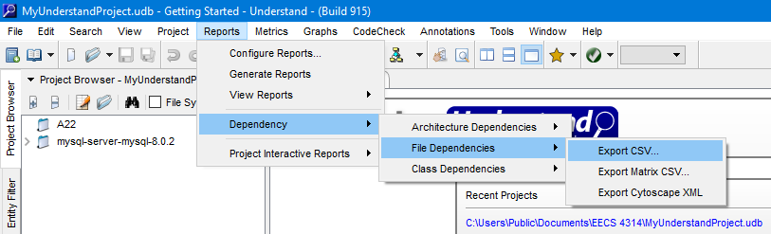
Dependency extraction using Understand
Dependency Extraction
Quantitative & Qualitative Analysis
Potential Risks & Limitations
Lessons Learned
Conclusions
Export
Notes:
TEAM 1

Slide 11
Dependency extraction using srcML
Dependency Extraction
Quantitative & Qualitative Analysis
Potential Risks & Limitations
Lessons Learned
Conclusions
Notes:
Team 3

Slide 12
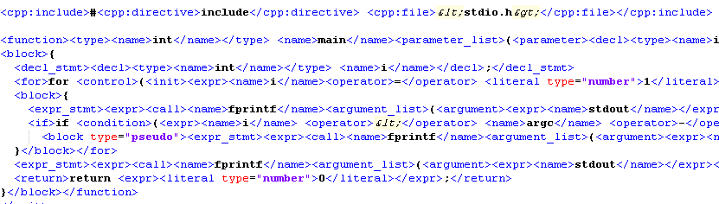
Dependency extraction using srcML
Dependency Extraction
Quantitative & Qualitative Analysis
Potential Risks & Limitations
Lessons Learned
Conclusions
.
Notes:
Team 3

Slide 13
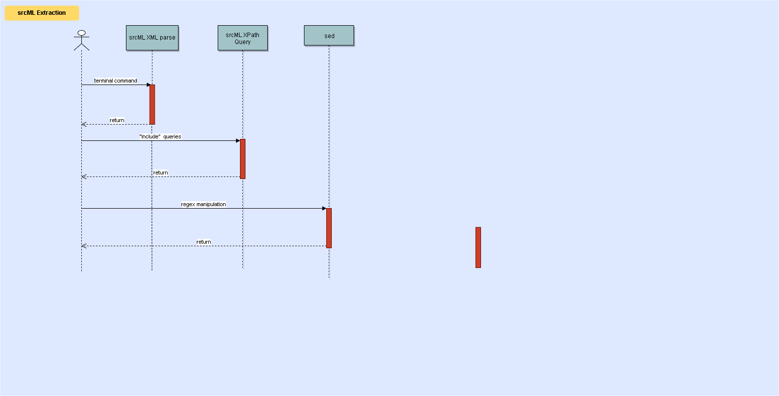
Dependency Extraction
Quantitative & Qualitative Analysis
Potential Risks & Limitations
Lessons Learned
Conclusions
Notes:
Team 3

Slide 14
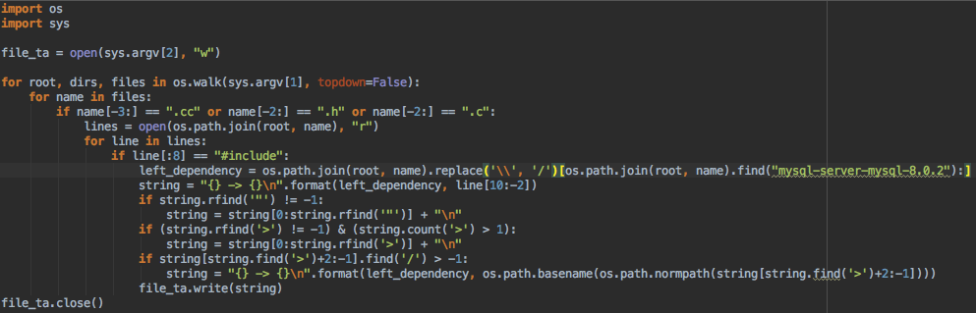
Dependency Extraction using Program
Dependency Extraction
Quantitative & Qualitative Analysis
Potential Risks & Limitations
Lessons Learned
Conclusions
Wrote a Python script that walks through the MySQL source code folder.
Checks every “.cc”, “.c” and “.h” file. Parses each line of the file and writes the dependency between the current file and the files being included using “#include” to a raw.ta file.
https://github.com/azkevin/EECS4314/blob/master/A3/a3data/include.py
https://github.com/azkevin/EECS4314/blob/master/A3/a3data/test.raw.ta
Notes:
Team 2 (Anton)

Slide 15
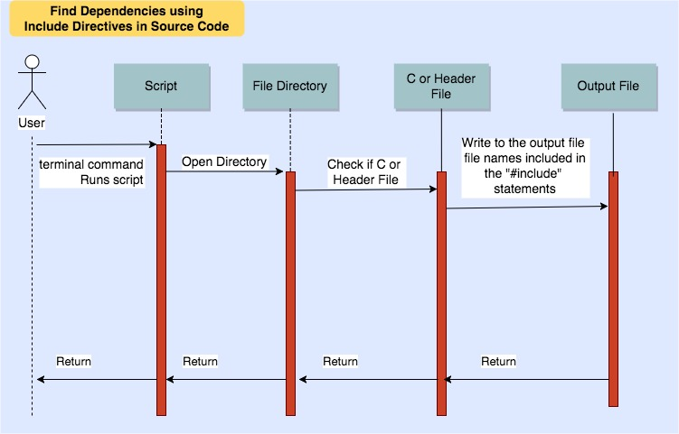
Dependency Extraction
Quantitative & Qualitative Analysis
Potential Risks & Limitations
Lessons Learned
Conclusions
Notes:
Team 2 (Anton)

Slide 16
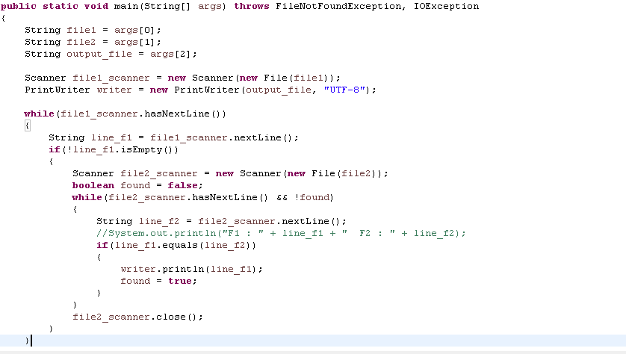
Finding Common Dependencies
Dependency Extraction
Quantitative & Qualitative Analysis
Potential Risks & Limitations
Lessons Learned
Conclusions
O(n²)

Slide 17
Quantitative analysis: Understand vs srcML
Dependency Extraction
Quantitative & Qualitative Analysis
Potential Risks & Limitations
Lessons Learned
Conclusions
Common
Understand:
66972 total dependencies
srcML:
41204 total dependencies
srcML
10132
Understand
35900
31072
Notes:
TEAM 3
Using our programmed java executable, we find the common dependencies between Understand and srcML.
The following venn diagram describes the number of dependencies that are common in Understand and srcML.
Total of approx 67000 dependencies in Understand and approx. 41000 dependencies in srcML.
Out of which the total number of shared dependencies is 31072.

Slide 18
Qualitative analysis: Understand vs srcML
Dependency Extraction
Quantitative & Qualitative Analysis
Potential Risks & Limitations
Lessons Learned
Conclusions
Used sampling calculator with the following data:
Understand: Confidence level of 95%, Confidence interval of +/- 6.92%, total population: 76,474. Sampling size: 200
Using stratified sampling method:
Overlap: 31,072/76,474 * 200 ~ 81 cases.
Understand: 35,900/76,474 * 200 ~ 93 cases.
srcML: 10,132/76,474* 200 ~ 26 cases.
Notes:
TEAM 3

Slide 19
Noticeable differences: Understand vs srcML
Dependency Extraction
Quantitative & Qualitative Analysis
Potential Risks & Limitations
Lessons Learned
Conclusions
The srcML tool only looks for the “Include” in the .c files, sometimes dependencies can be found in a different way such as inheritance.
Understand scans the whole source code directory, including all types of files such as .txt or .yy.

Slide 20
Quantitative Analysis: Our Program vs. srcML
Dependency Extraction
Quantitative & Qualitative Analysis
Potential Risks & Limitations
Lessons Learned
Conclusions
https://github.com/azkevin/EECS4314/blob/master/A3/a3data/srcML_Include_Common
Common
Our Program:
34236 total dependencies
srcML:
41204 total dependencies
33948
srcML
7256
Our Program
288
Notes:
Team 2 (Kevin)
In terms of a quantitative analysis of srcML and our program, we found
Our Program: 34236 total dependencies
srcML: 41204 total dependencies
Using our programmed java executable, we found the common dependencies from Our Program and srcML.
33948 shared dependencies
288 of those dependencies are unique to our program
7256 of those dependencies are unique to srcML

Slide 21
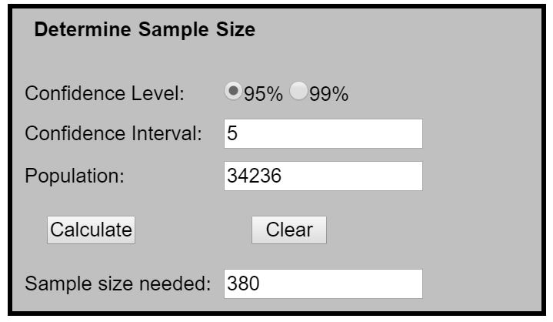
Qualitative Analysis: Our Program vs. srcML
Dependency Extraction
Quantitative & Qualitative Analysis
Potential Risks & Limitations
Lessons Learned
Conclusions
Notes:
Team 2 (Kevin)
Used sscalc (https://www.surveysystem.com/sscalc.htm) to determine an appropriate sample size to do stratified sampling, allowing us to to get an accurate representation
We arbitrarily chose...
Confidence Level: 95%
Confidence Interval (Margin of Error): 5%
Population (# of shared dependencies): ~34k
From here, it recommends choosing a sample size of 380.

Slide 22
Qualitative Analysis: Our Program vs. srcML
Dependency Extraction
Quantitative & Qualitative Analysis
Potential Risks & Limitations
Lessons Learned
Conclusions
Using stratified sampling method:
Overlap: (33948/41492) * 380 = ~311 cases.
Our Program: (288/41492) * 380 = ~3 cases.
srcML: (7256/41492)* 380 = ~66 cases.
~81.8%
~0.79%
~17.4%
Notes:
Team 2 (Kevin)
From here we can calculate the cases for each sample. For example on the overlap, we would divide the number of shared dependencies over the total number of dependencies, multiplied by the total sampling size, giving us 311
We can calculate the percentage by dividing the calculated sample size over the total sampling size, giving us 81%
We can see that the majority of the dependencies found between these two methods are common, although there are some unique cases for each

Slide 23
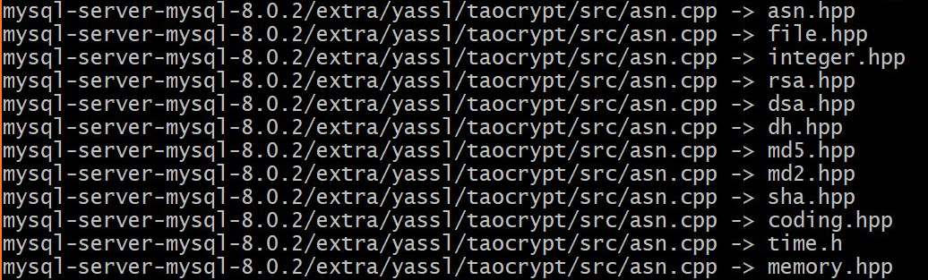
Noticeable Differences: Our Program vs. srcML
Dependency Extraction
Quantitative & Qualitative Analysis
Potential Risks & Limitations
Lessons Learned
Conclusions
Rationale as to why Kevin’s program is different from srcML
Notes:
Team 2 (Kevin)
I was curious to see why srcML had more unique cases than Our Program (7256 vs. 288)
So i used the pattern scanning command awk to print out the lines that were different between the common dependencies and the srcML dependencies
Majority of the reason why srcML had more unique cases was for the Python script we made, we forgot to check for .cpp and .hpp files when doing dependency extraction, which are c++ related files.
Originally we limited to certain files because it would give an exception if it tried reading a binary file

Slide 24
Quantitative Analysis: Understand vs.
Our Program
Dependency Extraction
Quantitative & Qualitative Analysis
Potential Risks & Limitations
Lessons Learned
Conclusions
Common
Understand:
66972 total dependencies
Our Program:
34236 total dependencies
Our Program
8,762
Understand
41,498
25,474
Notes:
Team 1

Slide 25
Qualitative Analysis: Understand vs.
Our Program
Dependency Extraction
Quantitative & Qualitative Analysis
Potential Risks & Limitations
Lessons Learned
Conclusions
Used sampling calculator with the following data:
Understand: Confidence level of 95%, Confidence interval of +/- 6.92%, total population: 76,474. Sampling size: 200
Using stratified sampling method:
Overlap: 25,474/75,729 * 200 ~ 67 cases.
Understand: 41498/75,729 * 200 ~ 110 cases.
Our Program: 8762/75,729* 200 ~ 23 cases.
Notes:
Team 1

Slide 26
Noticeable Differences: Understand vs.
Our Program
Dependency Extraction
Quantitative & Qualitative Analysis
Potential Risks & Limitations
Lessons Learned
Conclusions
Our Program does not detect .java, .cpp and .hpp files for dependency derivation
This explains why Our program detects much less number of dependencies than Understand
Our Program only looks for the “Include” in the .c files, sometimes dependencies can be found in a different way such as inheritance
Notes:
Team 2 (Kevin)

Slide 27
Potential Risks and Limitations
Dependency Extraction
Quantitative & Qualitative Analysis
Potential Risks & Limitations
Lessons Learned
Conclusions
srcML puts an extra XML tag before each keyword statement, we have to parse that with a java code to get the “include” statements.
srcML skips a significant number of dependencies since it only parse extensions that it supports.
Can’t get access to the source code of understand, comparing the tool as a black box is limited.
Can’t analyze the whole output, pick a sample.
Hidden dependencies that get generated after the build.
The Program we developed for method 3 skips certain extensions as well.
The program requires Python interpreter to run which is a limitations.
Notes:
Ayman

Slide 28

Lessons learned
Dependency Extraction
Quantitative & Qualitative Analysis
Potential Risks & Limitations
Lessons Learned
Conclusions
Notes:
Davood

Slide 29
Conclusion
Dependency Extraction
Quantitative & Qualitative Analysis
Potential Risks & Limitations
Lessons Learned
Conclusions
Many ways to extract dependencies
Trade-offs associated with each technique
Do the dependencies tell the real story?
Compare
Contrast
Conclude
Notes:
Davood

Slide 30
Question Period

